Slide 1
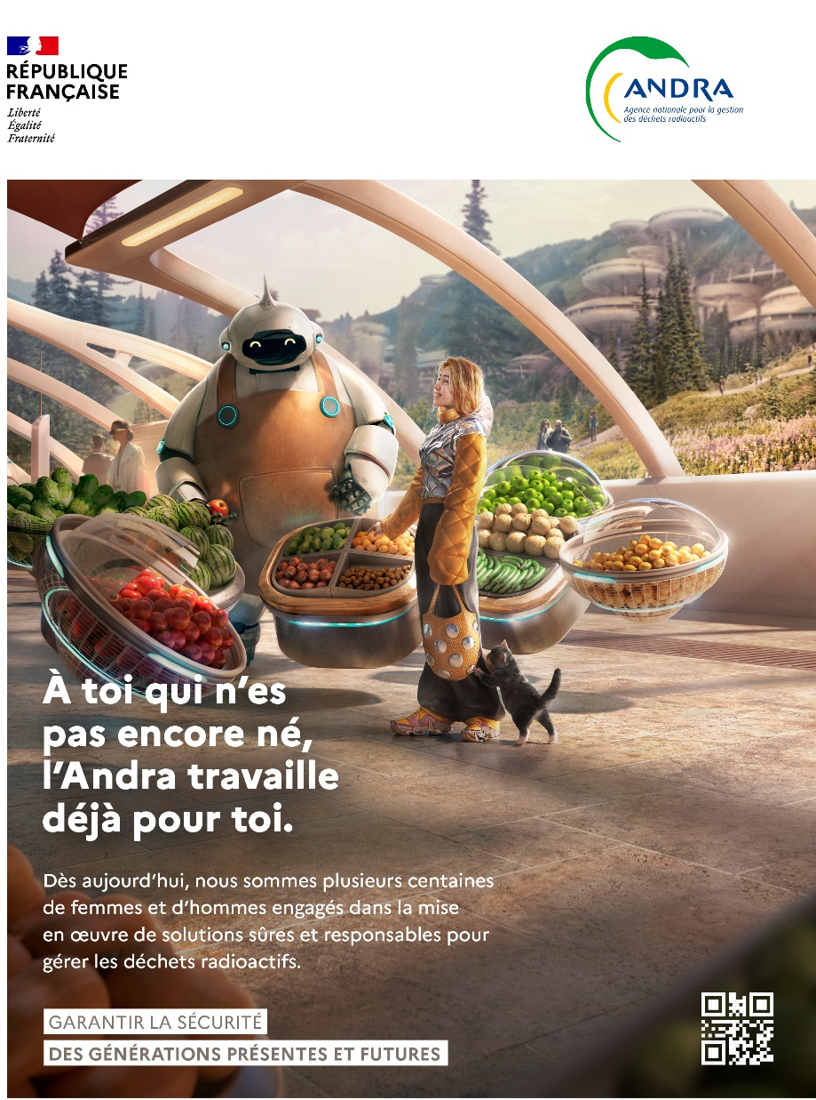
ere
Informing and Involving public in Waste Management for the long term
Fabien HUBERT
Head of International Relations Department
Andra
Notes:
Pour modifier la date et la référence Socrate en en-tête et pied de page de toutes les diapositives :
=> Onglet [Insertion] | En-tête et pied de page
- Dans le champ "Fixe", remplacez "jj mmmm aaaa" par la date et cochez la case "Date et heure"
- Dans le champ "Pied de page", modifiez la référence Socrate et cochez la case
- Vous pouvez également ajouter le numéro de diapositive en cochant la case associée
- Cliquez sur le bouton [Appliquer partout]

Slide 2
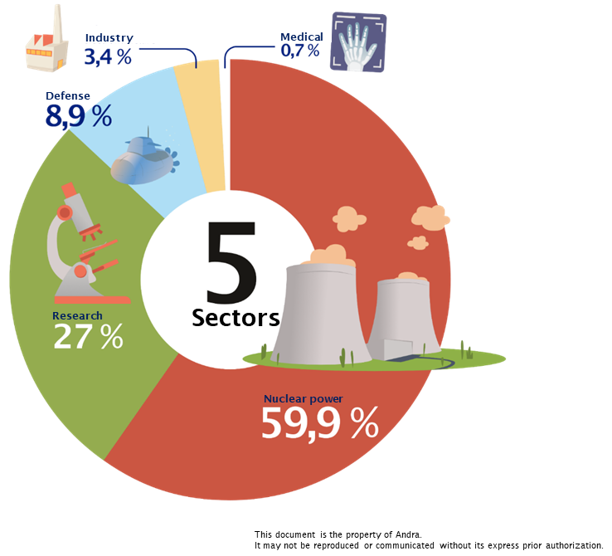
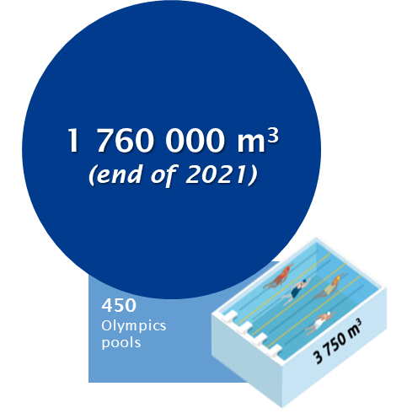
Radioactive waste origins, volumes and classification
This document is the property of Andra.
It may not be reproduced or communicated without its express prior authorization.

Slide 3
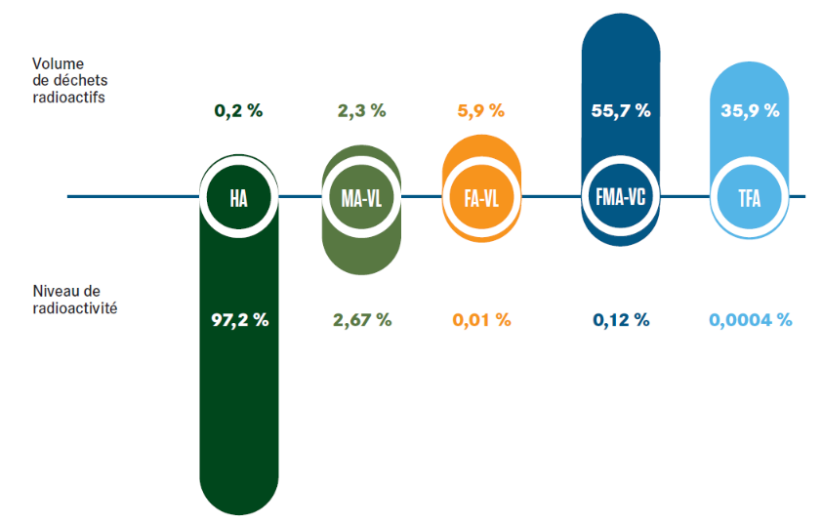
Breakdown of volume and radioactivity levels
97.5% of the waste concentrates less than 0.5% of the radioactivity
^{VS}
2.5% of the most radioactive waste concentrates more than 99.5% of the radioactivity
Radioactivity level

Slide 4
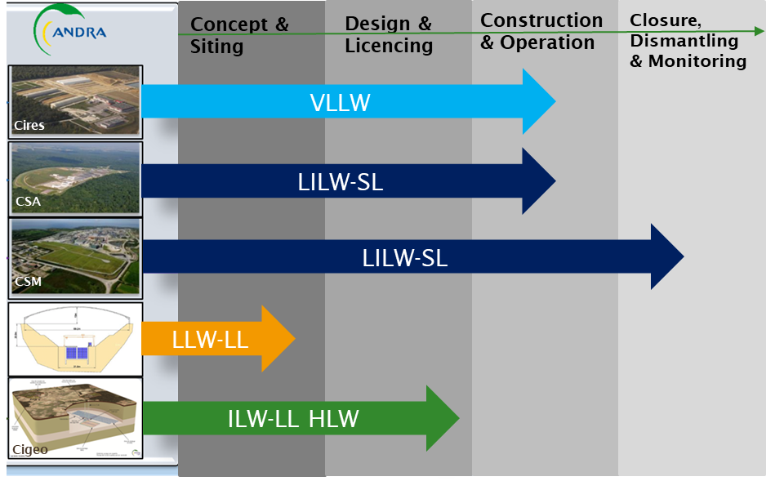
Disposal solutions and Projects status in France
91.6% of radioactive waste has a disposal solution
Radioactivity level %
Volume %
35.9%
0.00004%
55.7%
0.12%
5.9%
0.01%
2.3%
2.67%
0.2%
97.2%

Slide 5
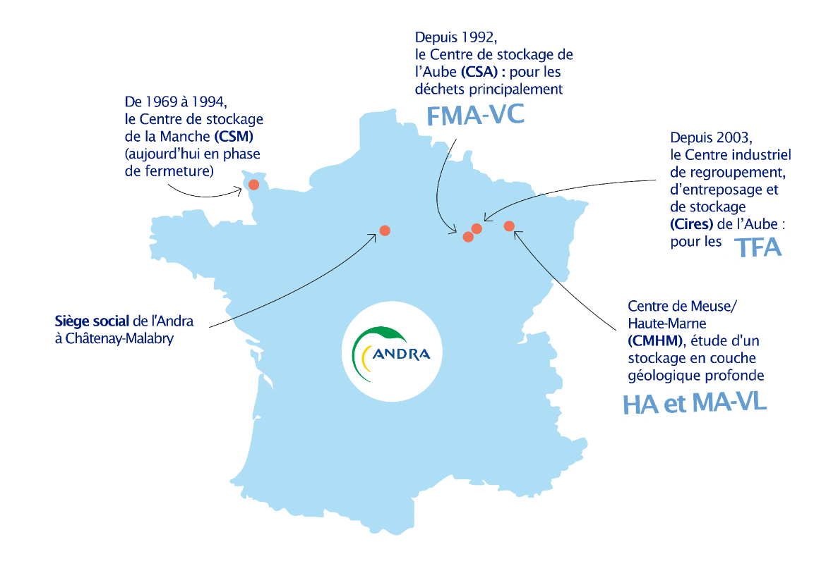
French National Radioactive Waste Management Agency
1French industrial and commercial public undertaking (EPIC)
Independent from radioactive waste producers since 1991
Legitimacy to contribute to French plans and policies
3 disciplines:
R&D, Design and Construction of Long-Term solutions
Operation and Surveillance of RAW disposals
National/international Outreach, dialogue and Public engagement
724 employees
298 M€ for the 2021 budget
To manage radioactive waste produced by past and present generations and make it safe for future generations.
Since 1992, Aube Disposal Facility (CSA): mainly for
From 1969 to 1994, the Manche Disposal Facility (CSM) (now in the closure phase)
LILW-SL
Since 2003, the Industrial facility for grouping, storage and disposal (Cires) in Aube: for VLLW
Andra headquarters in Châtenay-Malabry
Meuse/Haute-Marne Centre (CMHM), research into a deep geological repository
HLW and ILW-LL

Slide 6
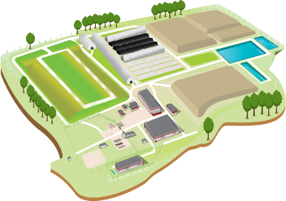
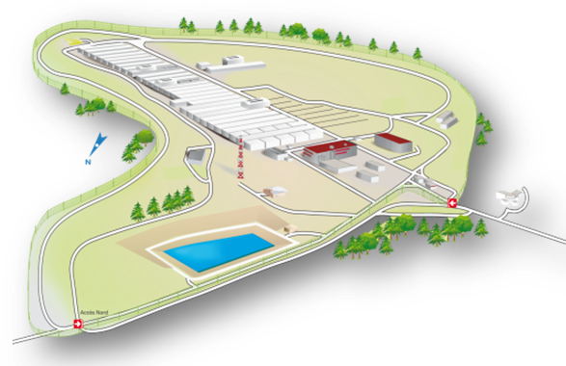
VLLW & LLW Disposals, 2023 key figures
VLLW Facility (Cires) - 650,000 m3 licensed capacity
20 years operation
Volume of waste disposed (2023) : 17,767 m3
Total volume disposed of (2003) : 469,076 m3
LLW Facility (CSA) – 1,000,000 m3 licensed capacity
31 years operation
Volume of waste disposed (2023) : 7,274 m3
Total volume disposed of (2003) : 378,579 m3
Rq: (527,000 m3 disposed of at the CSM, closed and in surveillance since 2003
And more than :
3,500 visitors
70 local projects sponsored/supported

Slide 7
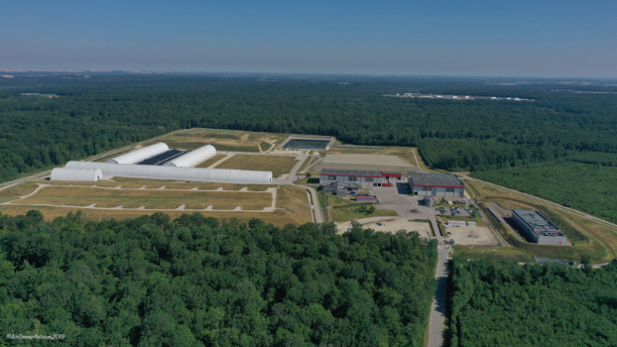
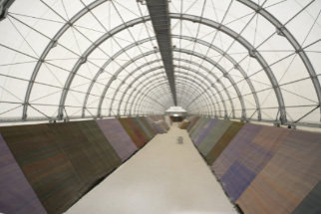
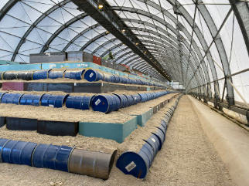
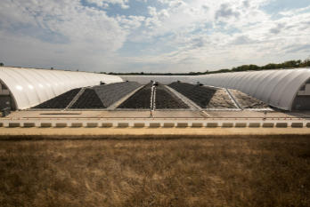
Cires

Slide 8
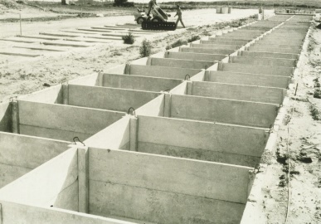
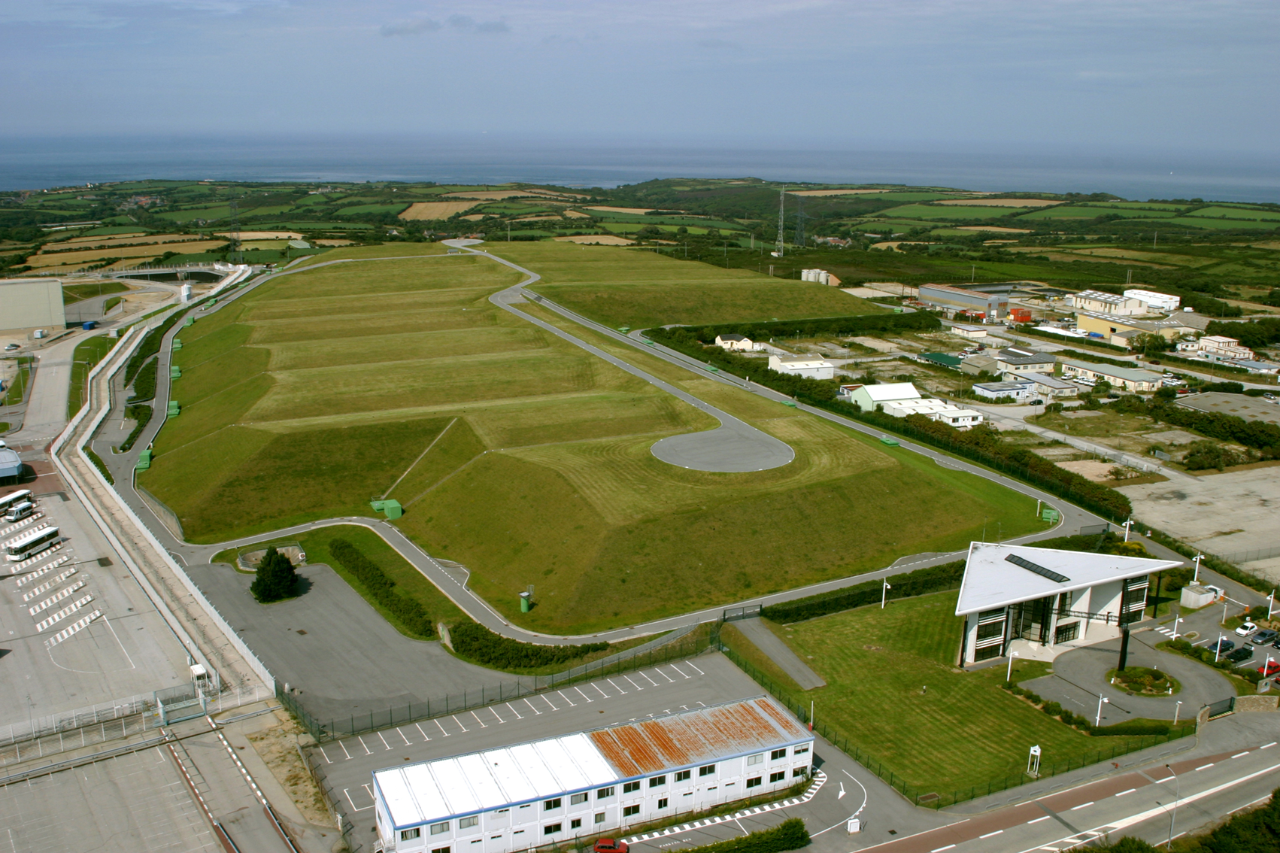
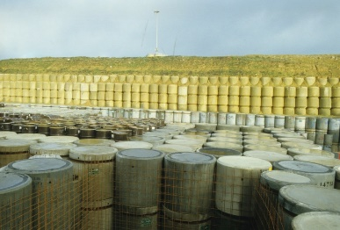
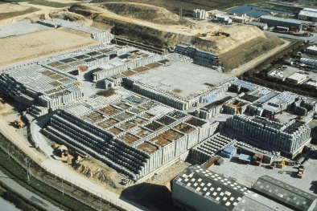
CSM

Slide 9
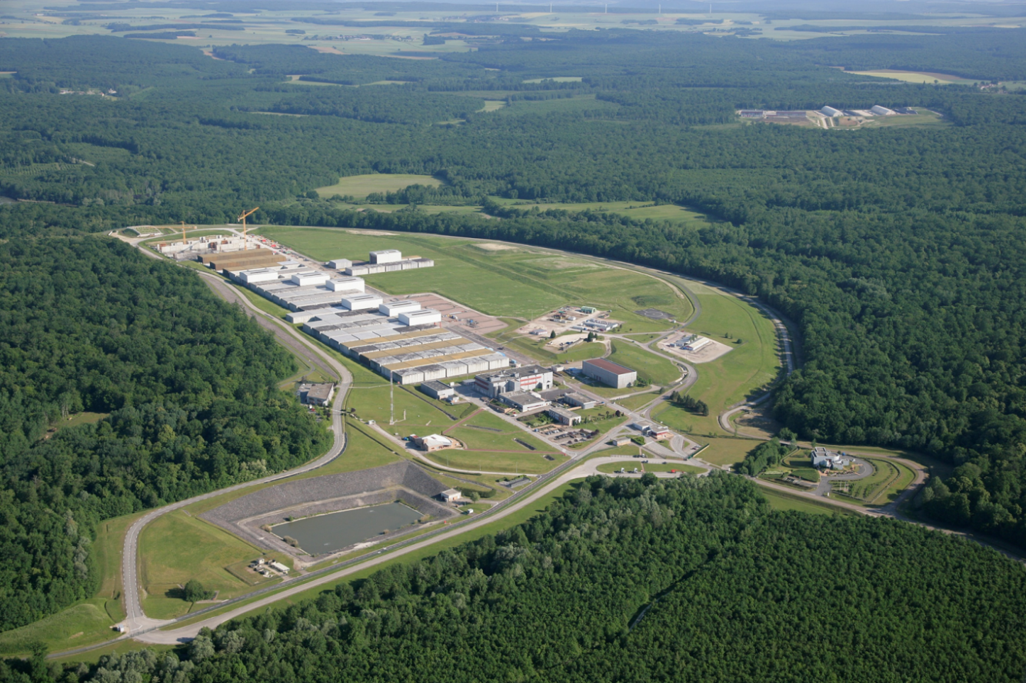
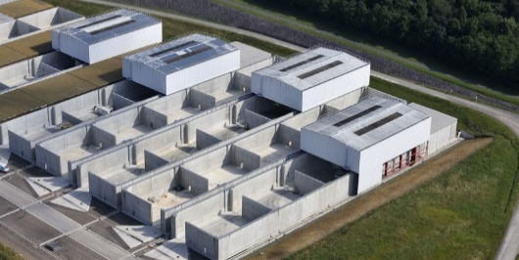
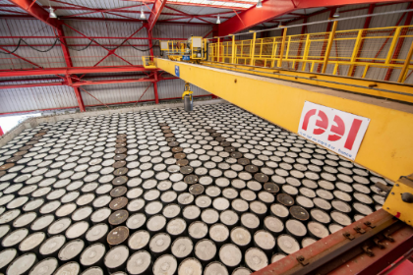
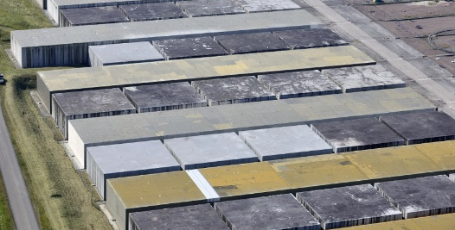
CSA

Slide 10
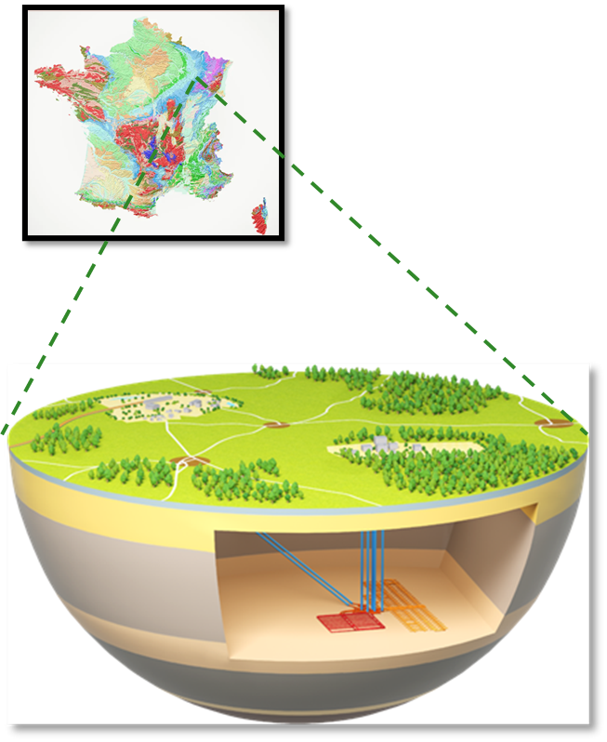
Cigéo, the French Deep Geological Repository project
Current status

Slide 11
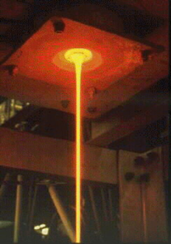
ILW-LL and HLW from reprocessing
Waste categories from Spent Fuel reprocessing
94 to 96 %
3-5 %
1%
U
94 to 96 %
Compacted hulls and end caps
Fission products
ILW-LL
(~73,000 m³ and 60 % already produced)
Maintenance and activated waste, solidified effluents
HLW
( 10,000 m³ 40 % already produced)
Notes:
HLW are coming from the reprocessing of spent fuel.
In this process, 95 to 97% of spent fuel material (U and Pu) are recycled. The remaining 3 to 5% are fission products and minor actinides that constitute the ultimate waste. These HLW are vitrified: incorporated and permanently immobilized in a glass matrix before being packaged.
ILW-LL is the result of 60 years of nuclear history. They are partly coming from the reprocessing of spent fuel (as for hull and end cap) and partly generated by the operation of nuclear facilities (maintenance and activated waste, solidified effluents, ..). These wastes are placed in steel, stainless steel or concrete packages.
The conditioned volume of waste that will have to be disposed of in Cigéo is: 75,000 m³ for ILW-LL (60% already produced) and 10,000 m³ for HLW (40% already produced).

Slide 12
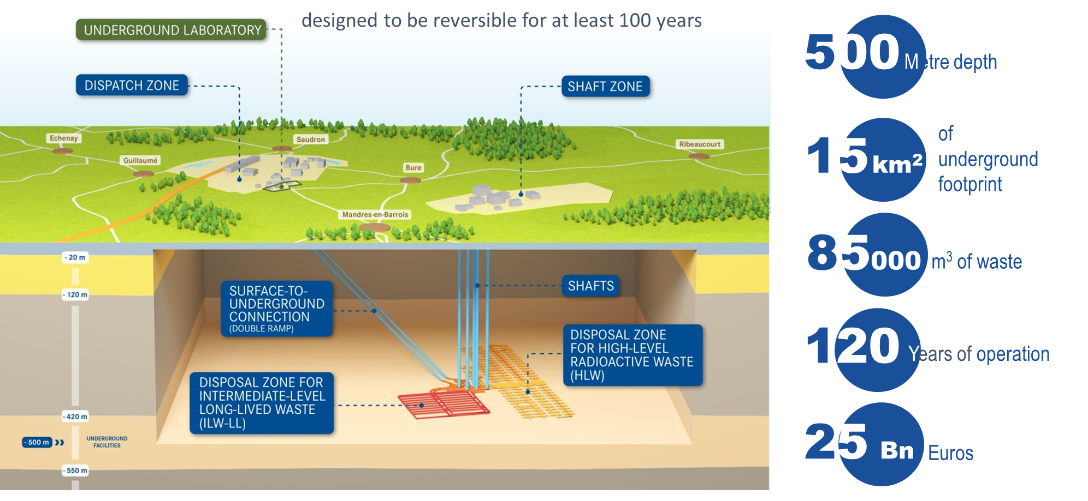
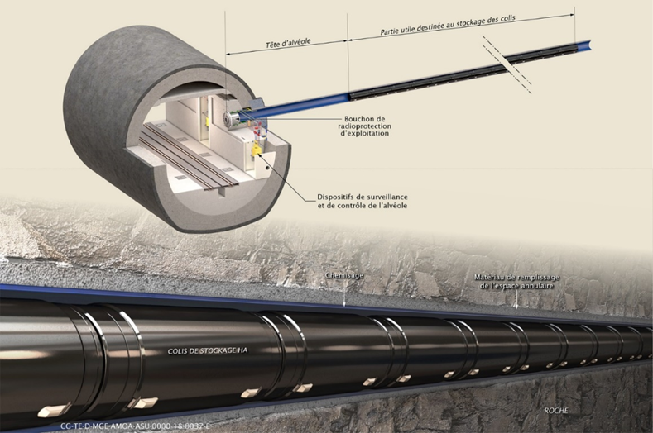
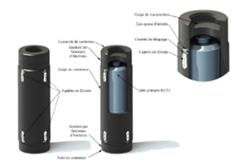
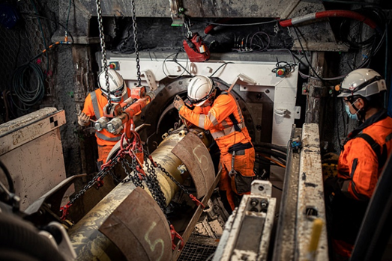
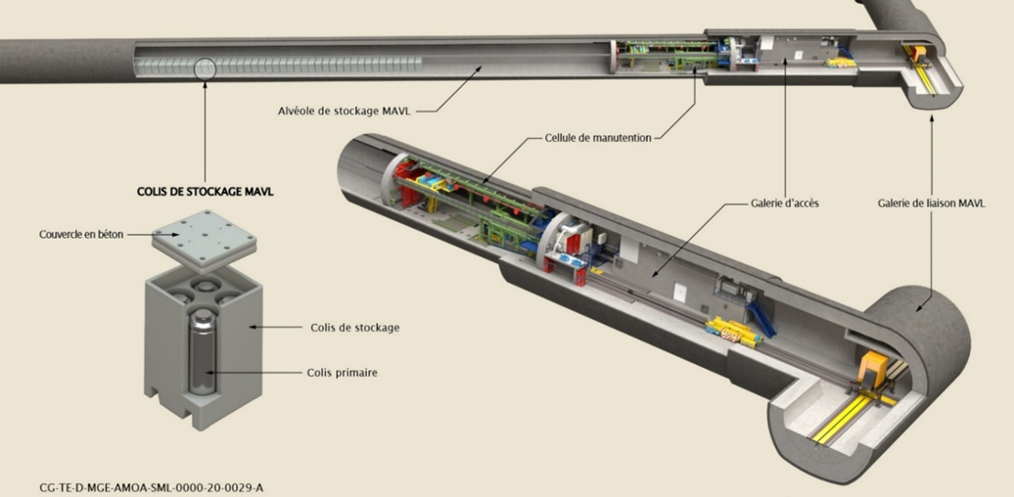
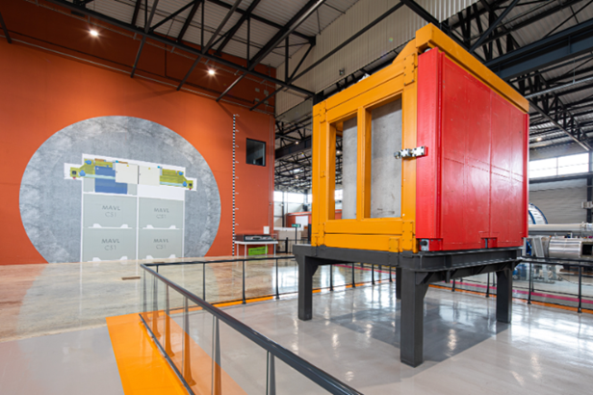
Cigéo : A Mature Project

Slide 13
From public information to effective public involvement
Notes:
Lien vers la banque d’images : L:\Formulaires_ANDRA\Andra ModelePresentation_version_2018

Slide 14
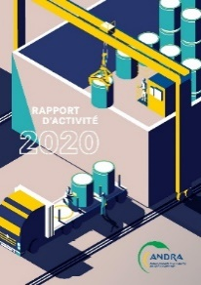
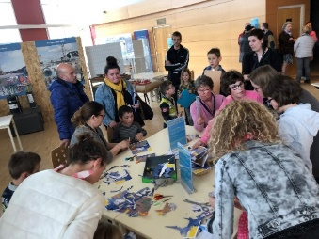
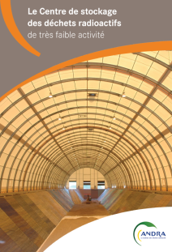
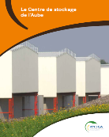
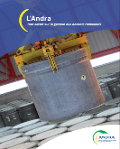
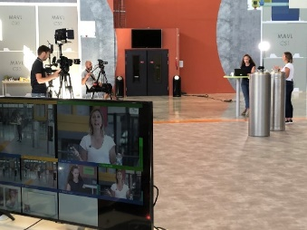
For 30 years, the pillars for building and maintaining trust
INFORMATION
DIALOGUE
CONSULTATION
Notes:
Here are the
- the first lesson is not to become overconfident because we know how quickly trust can be lost, so we should never believe that it has been won
- do not be afraid to repeat yourself: do not believe that because you have already said or done something, that box is ticked; you have to constantly maintain your efforts to inform, explain and discuss
- it is a difficult subject that cannot be managed alone: the support of local and national elected officials is essential.

Slide 15
The stakeholder involvement process
Conduct a dialogue
Participate in local life
Create interest & be visible
Inform & explain
Consult
Notes:
What we want is to create links between citizens and the subject of radioactive waste.
In order to accomplish that, we have created a range of tools, from the simplest to the most complicated, ranging from basic information to a close relationship and co-construction.

Slide 16
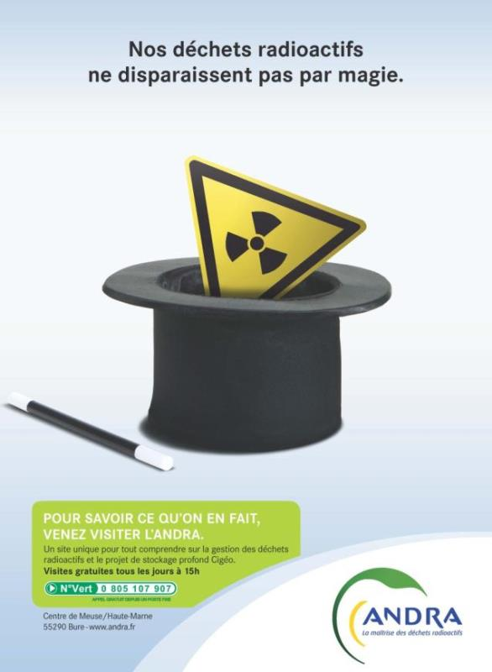
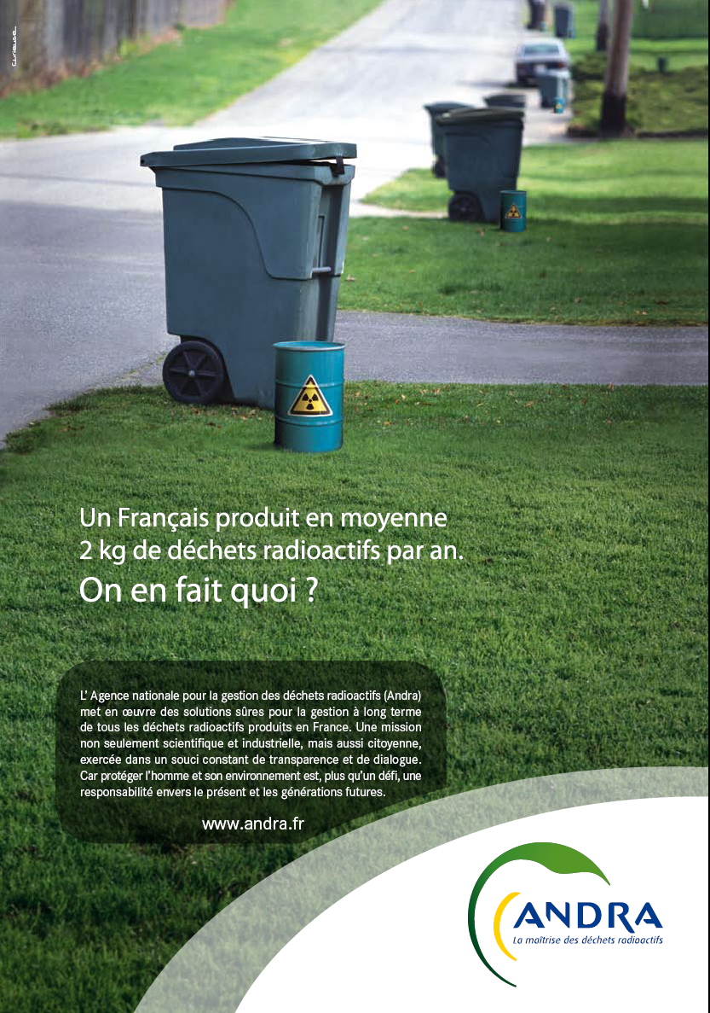
Catch the public’s interest
16
DICOD/18-0123
In order to create a specific debate on radioactive waste
INTEREST
On average, one French person produces 2 kg of radioactive waste per year.
What do we do with it?
Our waste doesn’t disappear by magic !
Notes:
First, our aim is to capture the public’s interest in order to create a specific debate on radioactive waste. As the debate on nuclear power is quite intense in France, we have to raise awareness of the collective responsibility that radioactive waste represents.
So our goal is to reinforce Andra’s image, through advertising, for example, as you can see here.

Slide 17
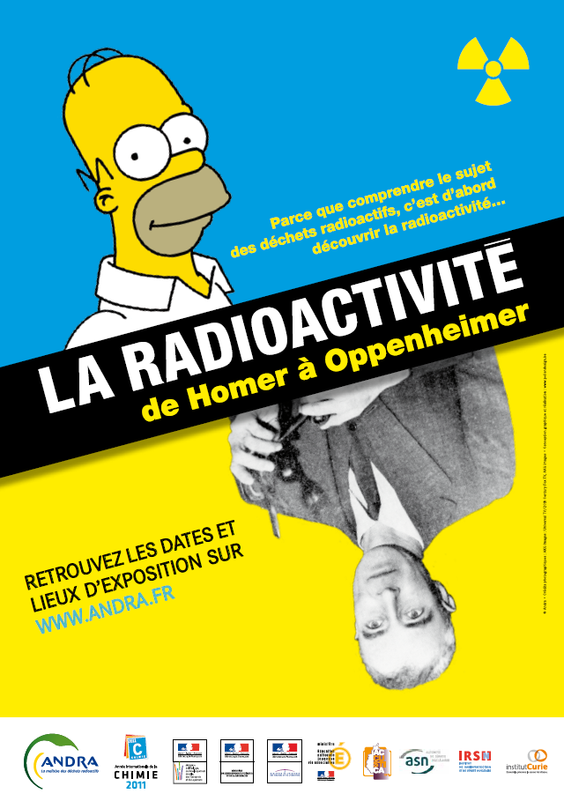
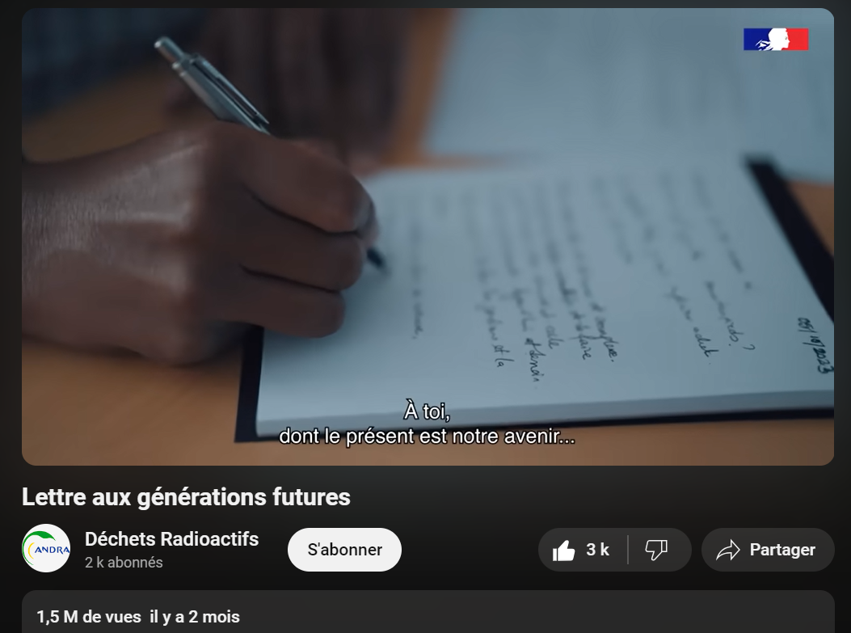
Create interest and be visible
17
DICOD/18-0123
Create links between the citizens and the subject of radioactive waste
Exhibition (in Paris and project area) : “Radioactivity, from Homer to Oppenheimer”
INTEREST
Video “Letter to future generation” (1,5 million views)
“To you whose present is our future”

Slide 18
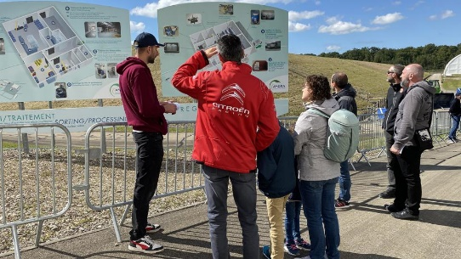
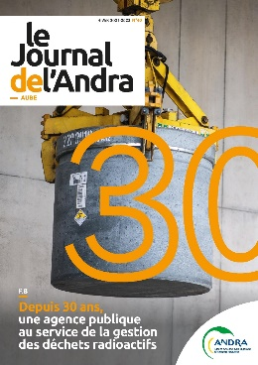
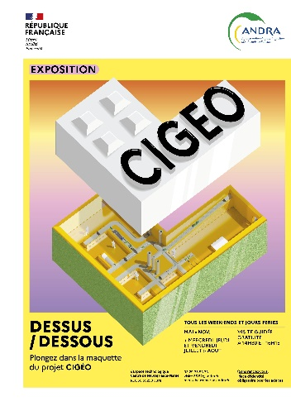
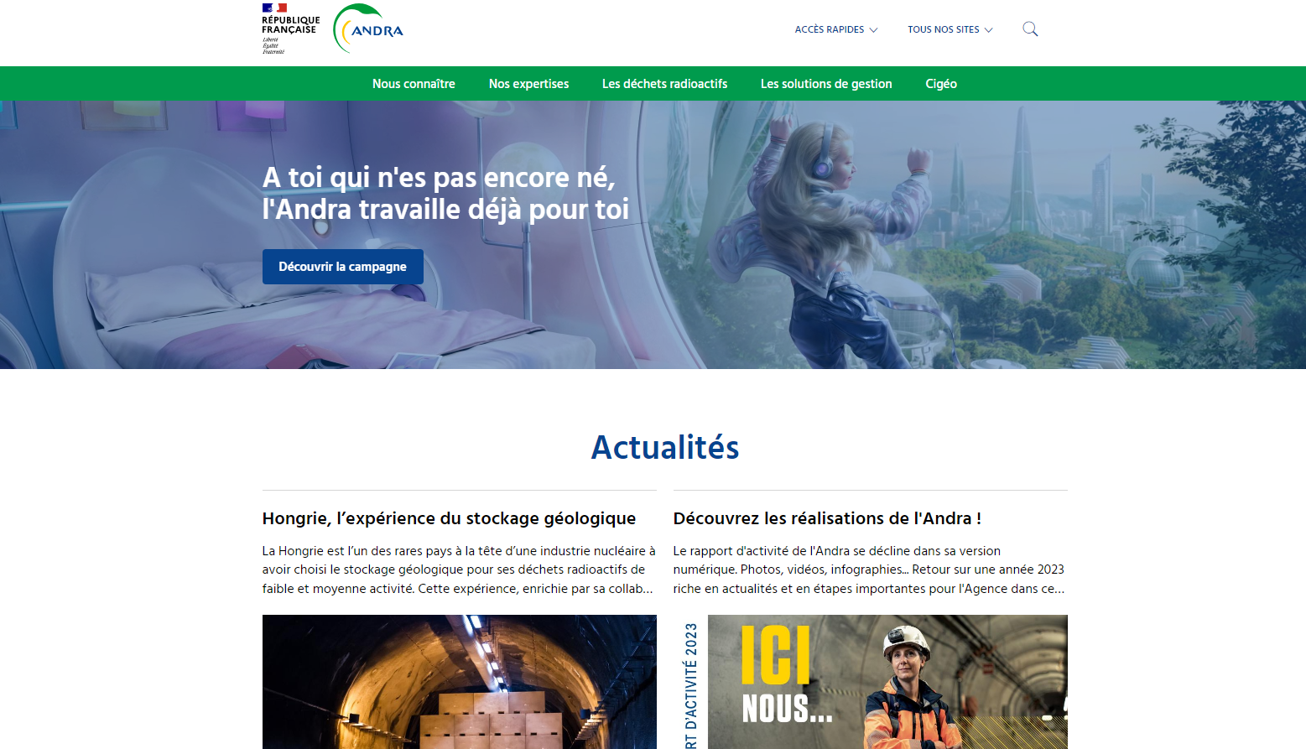
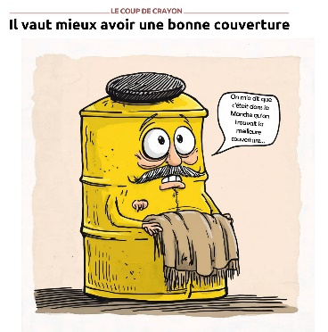
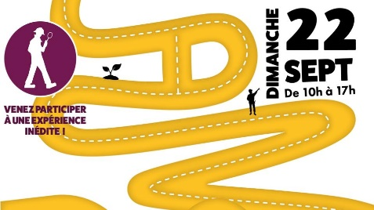
Inform the public
18
DICOD/18-0123
To create links between citizens and the subject of radioactive waste
Visitor centres and temporary exhibitions
INFORMATION
Brochures, periodicals, videos, websites, etc.
Notes:
Second, the purpose is to provide full in-depth information to the public
In Bure where the underground lab is located, a big visitors’ centre enables the public to find out about all aspects of the project.
This centre is open every weekend and offers guided tours to all members of the public without having to book.
This may sound anecdotal, but the mayors of the small villages around the facility have a permanent access pass. This has turned out to be quite an efficient way to build trust.
We also put a great deal of effort into younger audiences. We provide educational material, we organize conferences and visits and we welcome a lot of students on our sites.

Slide 19
Conduct a dialogue
19
DICOD/18-0123
With whom ?
Opinion leaders
Media
Digital influencers
DIALOGUE
Participatory democracy
Young people
Targets of the dialogue
Industry and business
Elected officials
An increasing dialogue
Developing and maintaining a dialogue with the public and stakeholders by involving them :
To improve the trust and transparency of Andra's activities
To develop a closer relationship with interested public and stakeholders
Nuclear sector
Civil society
Scientific world
Institutions
Notes:
Second, the purpose is to provide full in-depth information to the public
In Bure where the underground lab is located, a big visitors’ centre enables the public to find out about all aspects of the project.
This centre is open every weekend and offers guided tours to all members of the public without having to book.
This may sound anecdotal, but the mayors of the small villages around the facility have a permanent access pass. This has turned out to be quite an efficient way to build trust.
We also put a great deal of effort into younger audiences. We provide educational material, we organize conferences and visits and we welcome a lot of students on our sites.

Slide 20
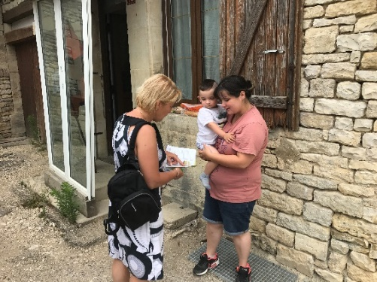
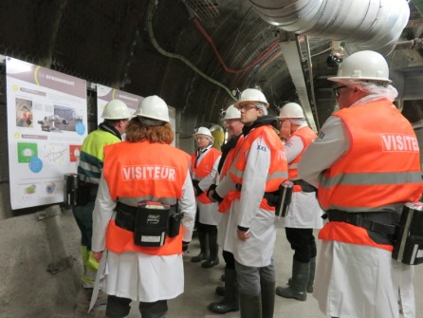
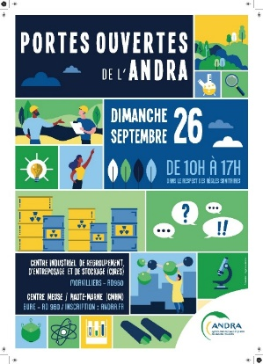
Conduct a dialogue
20
DICOD/18-0123
To engage with the public
10 000 visitors per year
900 personnes on the Open Day
DIALOGUE
Door-to-door campaigns in local communities
Press tours and trips
Open days
Notes:
Second, the purpose is to provide full in-depth information to the public
In Bure where the underground lab is located, a big visitors’ centre enables the public to find out about all aspects of the project.
This centre is open every weekend and offers guided tours to all members of the public without having to book.
This may sound anecdotal, but the mayors of the small villages around the facility have a permanent access pass. This has turned out to be quite an efficient way to build trust.
We also put a great deal of effort into younger audiences. We provide educational material, we organize conferences and visits and we welcome a lot of students on our sites.

Slide 21
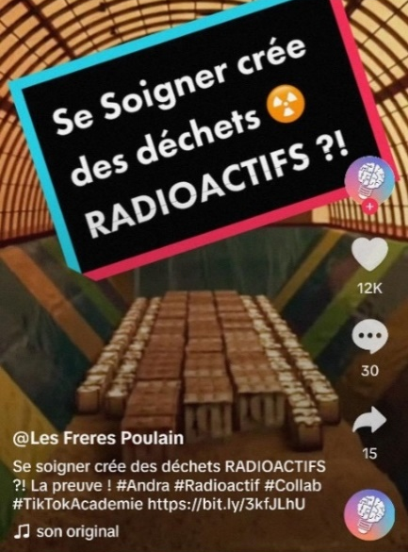
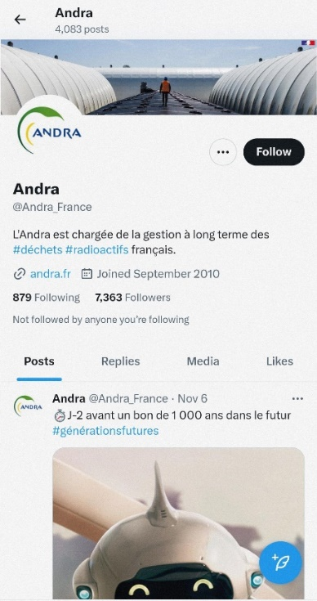
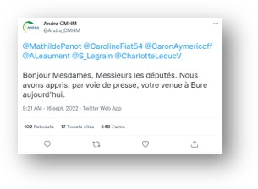
Extend dialogue means to new medias
DIALOGUE
Social medias :
a tool to interact widely and directly with stakeholders
Partnerships with responsible influencers on Web (Youtube/Tik Tok)
Health care creates radioactive waste ?
Message to members of Parliament
How to build an eternal memory on radioactive waste ?
Notes:
Dialogue means encouraging real discussions and not only top-down communication.
To do that, we increase the number of opportunities to meet directly with the public.
For instance we organise open days once a year, where we welcome 1000 people to the facility. And on those days, we rely on our employees, whom we coach, inform and train, to answer visitors’ questions for example on the occasion of door to door campaigns

Slide 22
Innovate in dialogue
To enlarge our audience
Science fiction and adventure novel
DIALOGUE
“Nothing in life is to be feared, all need to be understood” (Marie Curie)
Role-playing a parliamentary debate
Radio-actif podcast
Series of 6 episodes on memory “Tomorrow in 1000 years”
Street Art – Argadol
Mural at the Aube disposal facility
Notes:
It has to be said that we sometimes feel like we have gone round in circles for the last 30 years because the same questions always come up.
That is why we try to talk about the subject in a different way, using other means of expression such as science fiction, street art (here you can see a mural with Einstein and Marie Curie done by a local street artist on the surface disposal structures), or podcasts…

Slide 23
Consult the public
23
DICOD/18-0123
To involve in the solution process
Between 2018 and 2022, consultation resulted in:
CONSULTATION
39
organised meetings
1723
6
participants:
the general public, elected officials, government and community representatives, associations, etc.
areas covered: water cycle, transport infrastructure, power supply, and planning for the space and living environment
Notes:
The last step is to involve some local stakeholders and residents: some issues are not decided yet.
Others can still be improved.
Thus, we have identified topics in the project which we can build together and develop with the population.
Since 2017 we have had a formal consultation roadmap with workshops organised regularly on specific topics such as local integration.

Slide 24
Involve the territory and consult inhabitants
24
DICOD/18-0123
INVOLVE
National citizens’ conference
Local public meeting
Notes:
HCTISN Un groupe de suivi des démarches de concertation sur le projet Cigéo a été mis en place par le HCTISN afin d’assurer leur articulation et complémentarité. Une trentaine de parties prenantes sont membres du groupe qui se réunit à 3 à 4 fois par an.
, CNDP,
GT PNGMDR
CLI, réunions en mairie

Slide 25
Andra is also a major actor in the region
Through taxes
Local purchases
Support to local initiatives
Job market
Notes:
Fiscalité
Budget mobilisé localement par l’Andra : 69,7 millions d’euros
5,9 millions d’euros de fiscalité locale directe, dont 3,4 millions d’euros en taxe foncière et 2,5 millions d’euros en contribution économique territoriale
Achats locaux
19,6 millions d’euros d’achats locaux, soit 1 597 commandes passées auprès de 417 entreprises locales de Meuse, de Haute-Marne, de l’Aube et de la Manche
Soutien à la vie locale
90 projets locaux soutenus par le Centre de Meuse/Haute-Marne
Près de 140 000 € investis

Slide 26
Examples of long-term participatory schemes
Notes:
Lien vers la banque d’images : L:\Formulaires_ANDRA\Andra ModelePresentation_version_2018

Slide 27
National consultation on the Industrial Pilot Phase
The industrial Pilot Phase covers the first 15 -20 years of Cigéo, aiming to :
To consolidate Cigeo Design and Safety Demonstration
To test Cigéo reversible operability
To refine long-term Governance rules of Cigéo and its staged development
To associate Public and stakeholder
To feed the Law on Cigéo continuation conditions
In 2021, Andra organized a Citizen’s Conference to :
To engage non-experts citizens in producing recommendations on the content and purpose of the Industrial Pilot Phase
In a process where “real people” (randomly selected, volunteers, indemnified, progressively informed and trained) have legitimacy to address requirements on such phase
Citizens remain engaged and informed; they can be involved in some of Andra’s initiatives.
Notes:
Pour mettre des mots en exergue : gras + couleur
-----------------------------------------------------
Police courante : Lucida Sans

Slide 28
Local consultation on Cigeo’s regional integration
In 2023, Andra set-ups a local monitoring group for preparing firsts Cigéo construction works on site.
To interact with Andra’s in organizing the first construction works on site, particularly with regards to nuisances (inhabitants and environment, and public information).
20 voluntary members : local inhabitants and local representatives (hunting, hiking, fishing associations).
The local monitoring group of Cigéo construction exists for several years until a Local Information Committee will be created (Legal).

Slide 29
In conclusion
A long way with ups and downs, but with limited step backwards
CONSULTATION
DIALOGUE
INFORMATION
INTEREST
An iterative process of learning and testing
DDP/DICOM/24-0015

Slide 30
ere
Thank you for your attention
Thank you for your attention
Contact : Fabien HUBERT
Fabien.hubert@andra.fr
Notes:
Pour modifier la date et la référence Socrate en en-tête et pied de page de toutes les diapositives :
=> Onglet [Insertion] | En-tête et pied de page
- Dans le champ "Fixe", remplacez "jj mmmm aaaa" par la date et cochez la case "Date et heure"
- Dans le champ "Pied de page", modifiez la référence Socrate et cochez la case
- Vous pouvez également ajouter le numéro de diapositive en cochant la case associée
- Cliquez sur le bouton [Appliquer partout]

